Slide 1
MSc Artificial Intelligence
Knowledge Engineering
Week 6, 26 October 2026
Notes:
This colour bar is to be used for Artificial Intelligence

Slide 2
Learning Outcomes
Move from classical ontologies to the Labelled Property Graph (LPG) model using Neo4j AuraDB.
Use the Cypher Query Language for pattern matching, multi-hop traversals, and graph manipulation.
Extract nodes and relationships from unstructured text using LLMGraphTransformer.
Develop schema-aware retrieval pipelines using GraphCypherQAChain and few-shot prompt engineering.

Slide 3
The Evolution of Knowledge Representation
Transitioning from classical ontologies to enterprise graph databases.
Classical ontologies (RDF/OWL) are excellent for strict semantic reasoning, data exchange, and global standardization.
Modern applications require flexibility, scalability, and fast multi-hop traversal speeds.
The industry standard has shifted toward the Labelled Property Graph (LPG) model used in systems like Neo4j.

Slide 4
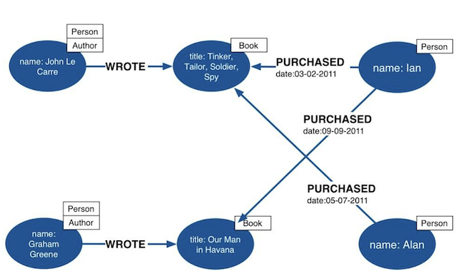
RDF Triples vs. LPG
RDF Triples use a strict Subject-Predicate-Object structure (e.g., Node -> Edge -> Node) to build classical semantic graphs.
In the classical RDF model, properties like timestamps or weights cannot be attached directly to relationships.
The Labelled Property Graph (LPG) model allows key-value properties to be embedded directly into both nodes and edges.
LPG is the enterprise standard used in graph databases like Neo4j to increase traversal speed and operational flexibility.
LPGs embed properties inside the nodes and edges.. Source: 7wData

Slide 5
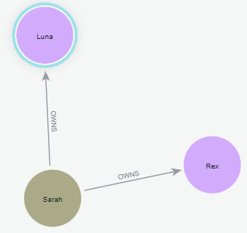
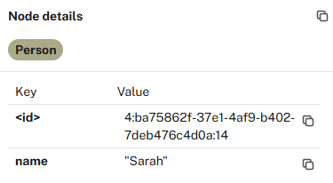
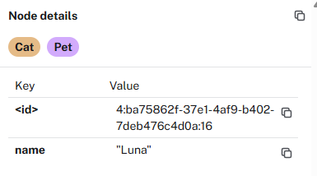
Core Components of an LPG Nodes & Labels
CREATE
(sarah:Person {name: 'Sarah'}),
(rex:Pet:Dog {name: 'Rex'}),
(luna:Pet:Cat {name: 'Luna'}),
(sarah)-[:OWNS {since: 2019}]->(rex),
(sarah)-[:OWNS {since: 2022}]->(luna)
Nodes: The fundamental "nouns" of the graph.
Labels: Categorical tags for grouping and indexing.
Multiple Assignments: Flexible classification on a single node (e.g., Luna is both :Pet and :Cat).

Slide 6
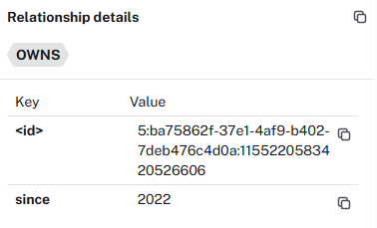
Core Components of an LPG : Relationships & Properties
Relationships: Directed "verbs" with a specific type.
Properties: Key-value data attached to nodes or edges.
The LPG Advantage: Rich context on relationships (e.g., since: 2022).

Slide 7
Introduction to Neo4j AuraDB
Fully Managed Cloud: Neo4j AuraDB is a fully managed cloud-based graph database service.
Native LPG Model: Eliminates rigid schemas and complex table JOINs.
Zero-Administration: Automated scaling, backups, and high availability.
Millisecond Traversals: Native relationship storage for lightning-fast multi-hop queries.

Slide 8
Setting Up Neo4j AuraDB
6.01 Neo4j AuraDB Setup Guide.pdf

Slide 9
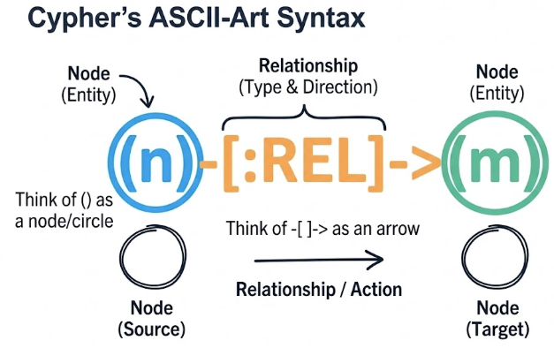
Cypher Query Language
Cypher is a declarative query language designed specifically for querying and updating graph databases.
It utilizes an ASCII-art inspired syntax to visually represent nodes, relationships, and directions (e.g., (n)-[:REL]->(m)).
The language allows users to focus on defining what graph patterns to match rather than programming how to retrieve them.
It serves as the primary mechanism for executing pattern matching and graph manipulation within Neo4j AuraDB.

Slide 10
Enforcing Data Integrity: Schema Constraints in Cypher
Syntax :
Action (CREATE CONSTRAINT prof_name): Establishes and names the database rule for easy management.
Safeguard (IF NOT EXISTS): Idempotency check; prevents script crashes if the constraint is already active.
Target (FOR (p:Professor)): Applies the rule to any node categorized with the Professor label (p acts as the temporary reference variable).
Rule (REQUIRE p.name IS UNIQUE): Dictates that the name property must not be duplicated across the database.
What happens when the university has two with same name ?
// Make the ID or Email unique instead of the name

Slide 11
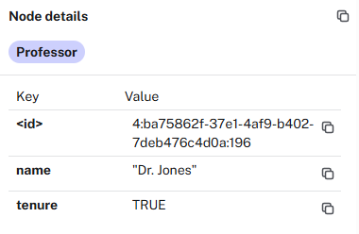

Populating the Graph: CREATE vs. MERGE
CREATE (The Blind Insert): Forces the database to write new nodes and edges every time the command runs.
  Risk: Executing the same script twice will duplicate your entire graph or immediately crash due to constraint violations.
MERGE (Match or Create): An idempotent, safe operation. It scans the database for the exact entity or pattern. If it finds it, it matches and binds to it. If it does not exist, it creates it.

Slide 12
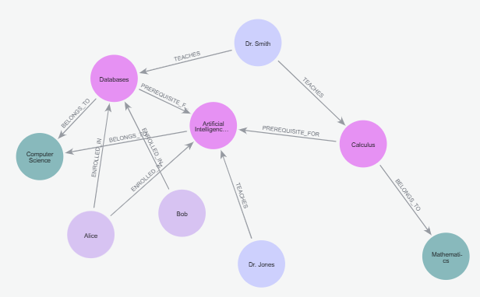
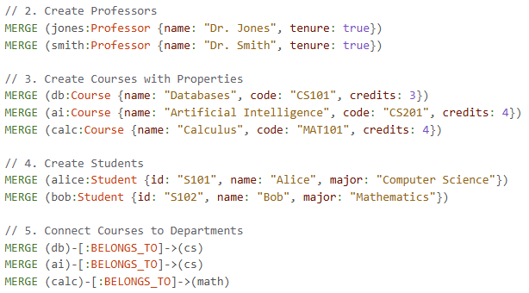
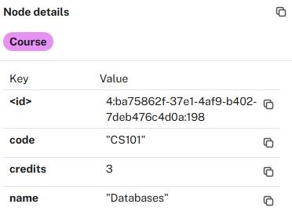
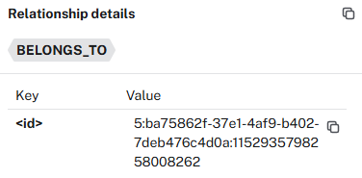
Populating the Graph: CREATE vs. MERGE

Slide 13

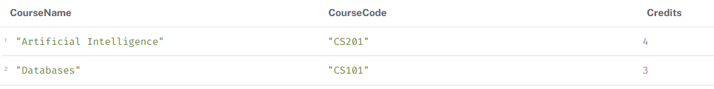
Pattern Matching: MATCH, WHERE, and RETURN
Cypher queries rely on drawing ASCII-art paths to visually map the data you want to retrieve: (:Label)-[:REL_TYPE]->(:Label).
1. Node Filtering & Ordering Finding all courses in the Computer Science department, sorted highest-to-lowest by credit value.

Slide 14

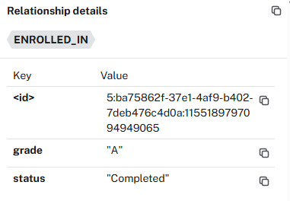
Pattern Matching: MATCH, WHERE, and RETURN
Cypher queries rely on drawing ASCII-art paths to visually map the data you want to retrieve: (:Label)-[:REL_TYPE]->(:Label).
2. Querying Relationship (Edge) Properties Relationships hold data, too. This query isolates the ENROLLED_IN edge (assigned to the variable e) to filter by status and extract the specific grade.

Slide 15

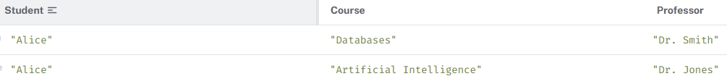
Multi-Hop Path Traversals (2-Hop Reasoning)
Graph databases excel at traversing multiple connections (hops) to link indirect data points.
In this example, we trace a 2-hop path to determine exactly which professors are teaching a specific student (Alice).
The Logical Path: Student (Alice) $\underset{→}{\text{ENROLLED_IN}}$Course $\underset{←}{\text{TEACHES}}$Professor

Slide 16

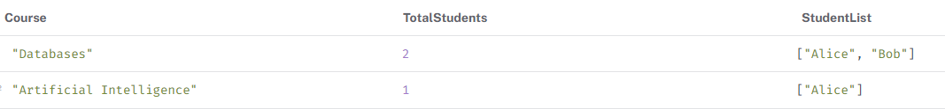
Graph Aggregations (COUNT & COLLECT)
A major advantage of Cypher over SQL is that it does not require an explicit GROUP BY clause. It automatically groups the results based on any non-aggregated columns included in your RETURN statement.
Aggregation (COUNT and COLLECT) This query counts the total number of students enrolled in each course and compiles their names into a list.

Slide 17
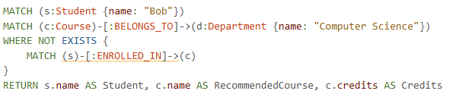
Negation (NOT EXISTS)
Negation Filtering (WHERE NOT EXISTS) You can use WHERE NOT EXISTS { ... } as a powerful filter.
Here, we use it to build a simple recommendation engine by finding Computer Science courses that Bob has not yet taken.

Slide 18


Essential Utility Commands
1. View the Entire Graph
Retrieves all connected nodes and their relationships. Useful for exploring small databases or verifying bulk inserts.
2. Wipe Database (Hard Reset)
Note: Since the Neo4j free tier allows only one active graph at a time, you will use this command frequently to wipe the database clean before building a new graph.

Slide 19
6.02 Lab Cypher Fundamentals.ipynb

Slide 20
Automated Knowledge Graph Construction from Unstructured Text
Utilize LangChain and LLMGraphTransformer to extract structured nodes and relationships directly from raw text.
Leverage Large Language Models (LLMs) strictly as semantic parsers to convert unstructured data into graph triples.
Populate your Neo4j AuraDB instance programmatically with the automatically generated knowledge graph.

Slide 21
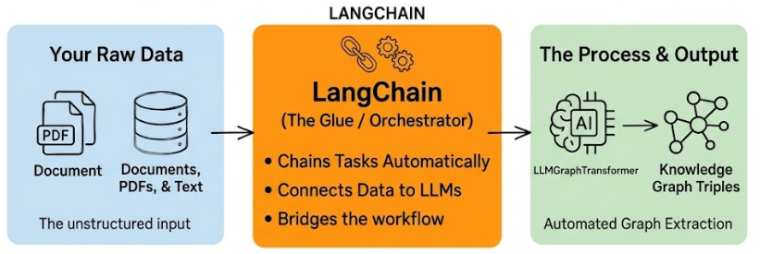

Introduction to LangChain (Pre-requisite Context)
LangChain is an orchestration framework designed to simplify the creation of applications powered by Large Language Models (LLMs).
It provides a modular and composable way to build complex workflows by offering components that can be chained together.
The core mechanism of the framework, chains combine LLMs with other utilities (like prompts and parsers) to execute a sequence of functions automatically.
We will use LangChain to orchestrate the semantic parsing process, connecting our raw documents to the LLMGraphTransformer to automate graph triple extraction.

Slide 22
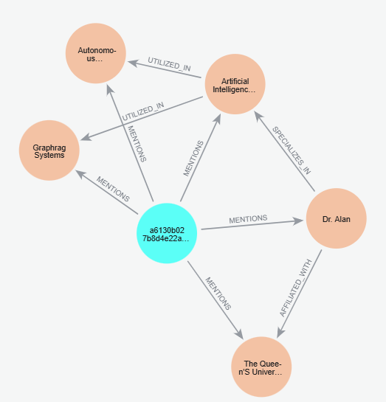
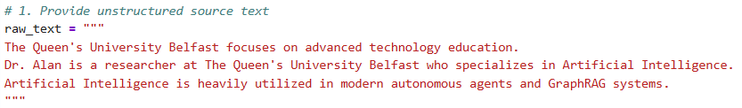
The Problem with Unconstrained Extraction
Inconsistent Node Types: Unconstrained LLMs categorize the same entity differently (e.g., classifying "AI" as Technology, Concept, or Field_Of_Study).
Invented Relationships: Models generate endless synonymous edges instead of a unified vocabulary (FOCUSES_ON, SPECIALIZES_IN, UTILIZES).
Source Node Bloat: The automatic include_source=True flag creates a central Document node with massive, often noisy, MENTIONS links to every entity.
Reality of Dynamic Unconstrained Extraction

Slide 23
The Consequence : Ontology Drift & Schema Fragmentation
Unpredictable Vocabulary: Fragmented graphs result when data meaning splits across multiple invented node labels.
Relationship Synonyms: Core actions become impossible to query simply (e.g., tracking who STUDIES vs WORKS_ON vs IS_EXPERT_IN).
GraphRAG Failures: Downstream AI agents cannot write reliable Cypher queries if the pipeline generates arbitrary edge names.

Slide 24
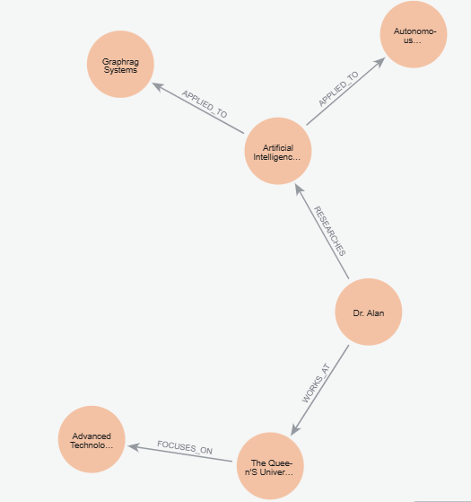
The Solution: Enforcing a Target Ontology
The Strategy: Restrict the LLMGraphTransformer to an explicit schema to guarantee structured, predictable extraction.
Applying schema constraints during extraction ensures the resulting data strictly follows our predefined graph model.
Strict schema constraints Extraction

Slide 25
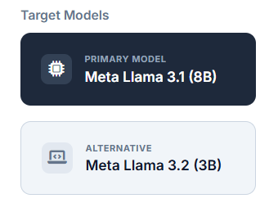

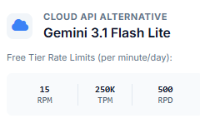
Introduction to Local LLM and Cloud LLM via API (Pre-requisite Context)
Environment Configuration
Before proceeding, you must configure a local Large Language Model environment using Ollama and Jupyter Notebook.
https://aistudio.google.com/apikey
RPM: Requests Per Minute
TPM: Tokens Per Minute
RPD: Requests Per Day

Slide 26
Local LLM
6.04 Automated KG Extraction Local.ipynb
Cloud LLM via API
6.04 Automated KG Extraction API.ipynb

Slide 27
Text-to-Cypher Pipeline & GraphRAG
The Goal: Building a resilient GraphCypherQAChain using Prompt Engineering.
Context: End-users cannot (and should not) write Cypher Query.
We will build a GraphRAG pipeline: an LLM will translate natural language directly into Cypher, query Neo4j, and return human-readable answers.
Run GraphCypherQAChain and analyze Text2Cypher failures when the LLM lacks property visibility.
Build a Few-Shot Prompt Template to enforce entity normalization and flexible relationship matching.

Slide 28
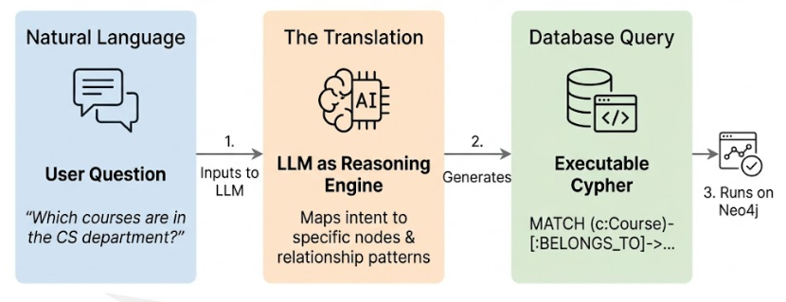
Introduction to Text2Cypher
Automated Translation Pipeline
Converts natural language questions directly into executable Cypher queries.
Allows non-technical stakeholders to query complex knowledge graphs without knowing database syntax.
Shifting from writing Cypher manually to engineering prompt architectures that force the LLM to write it reliably.

Slide 29
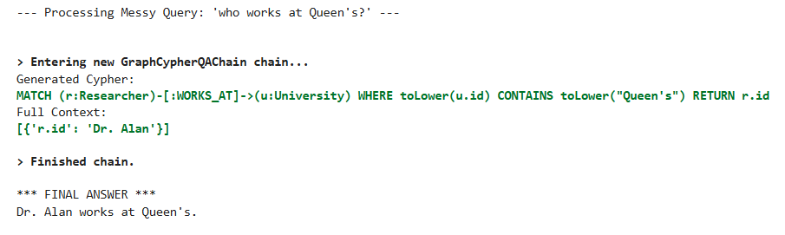
How GraphCypherQAChain Works
Orchestrates Text2Cypher by dynamically injecting the graph schema into the LLM prompt.
Generates and executes the Cypher query against Neo4j, then synthesizes a natural language answer.

Slide 30
The Problem: Entity Normalization & Directionality
The Issue: Naive Text2Cypher fails when human language is imprecise. If a user asks for "Queen's" instead of "Queen's University Belfast", or asks a question requiring a backward edge traversal, the LLM writes an exact-match query that returns nothing.
The Fix: Few-Shot Prompt Engineering We must instruct the LLM to write resilient Cypher:
Normalize Entities: Force the use of toLower() for case-insensitive matching.
Fuzzy Matching: Use CONTAINS instead of strict equality (=) for multi-word concepts.
Flexible Edges: Use bidirectional relationships (-[]-) when natural language directionality is ambiguous.
Syntax Safety: Require double quotes (“ ") for strings to prevent errors with apostrophes.

Slide 31
Local LLM
6.06 Text2Cypher Pipeline Local.ipynb
Cloud LLM via API
6.06 Lab Text2Cypher Pipeline API.ipynb

